Slide 1
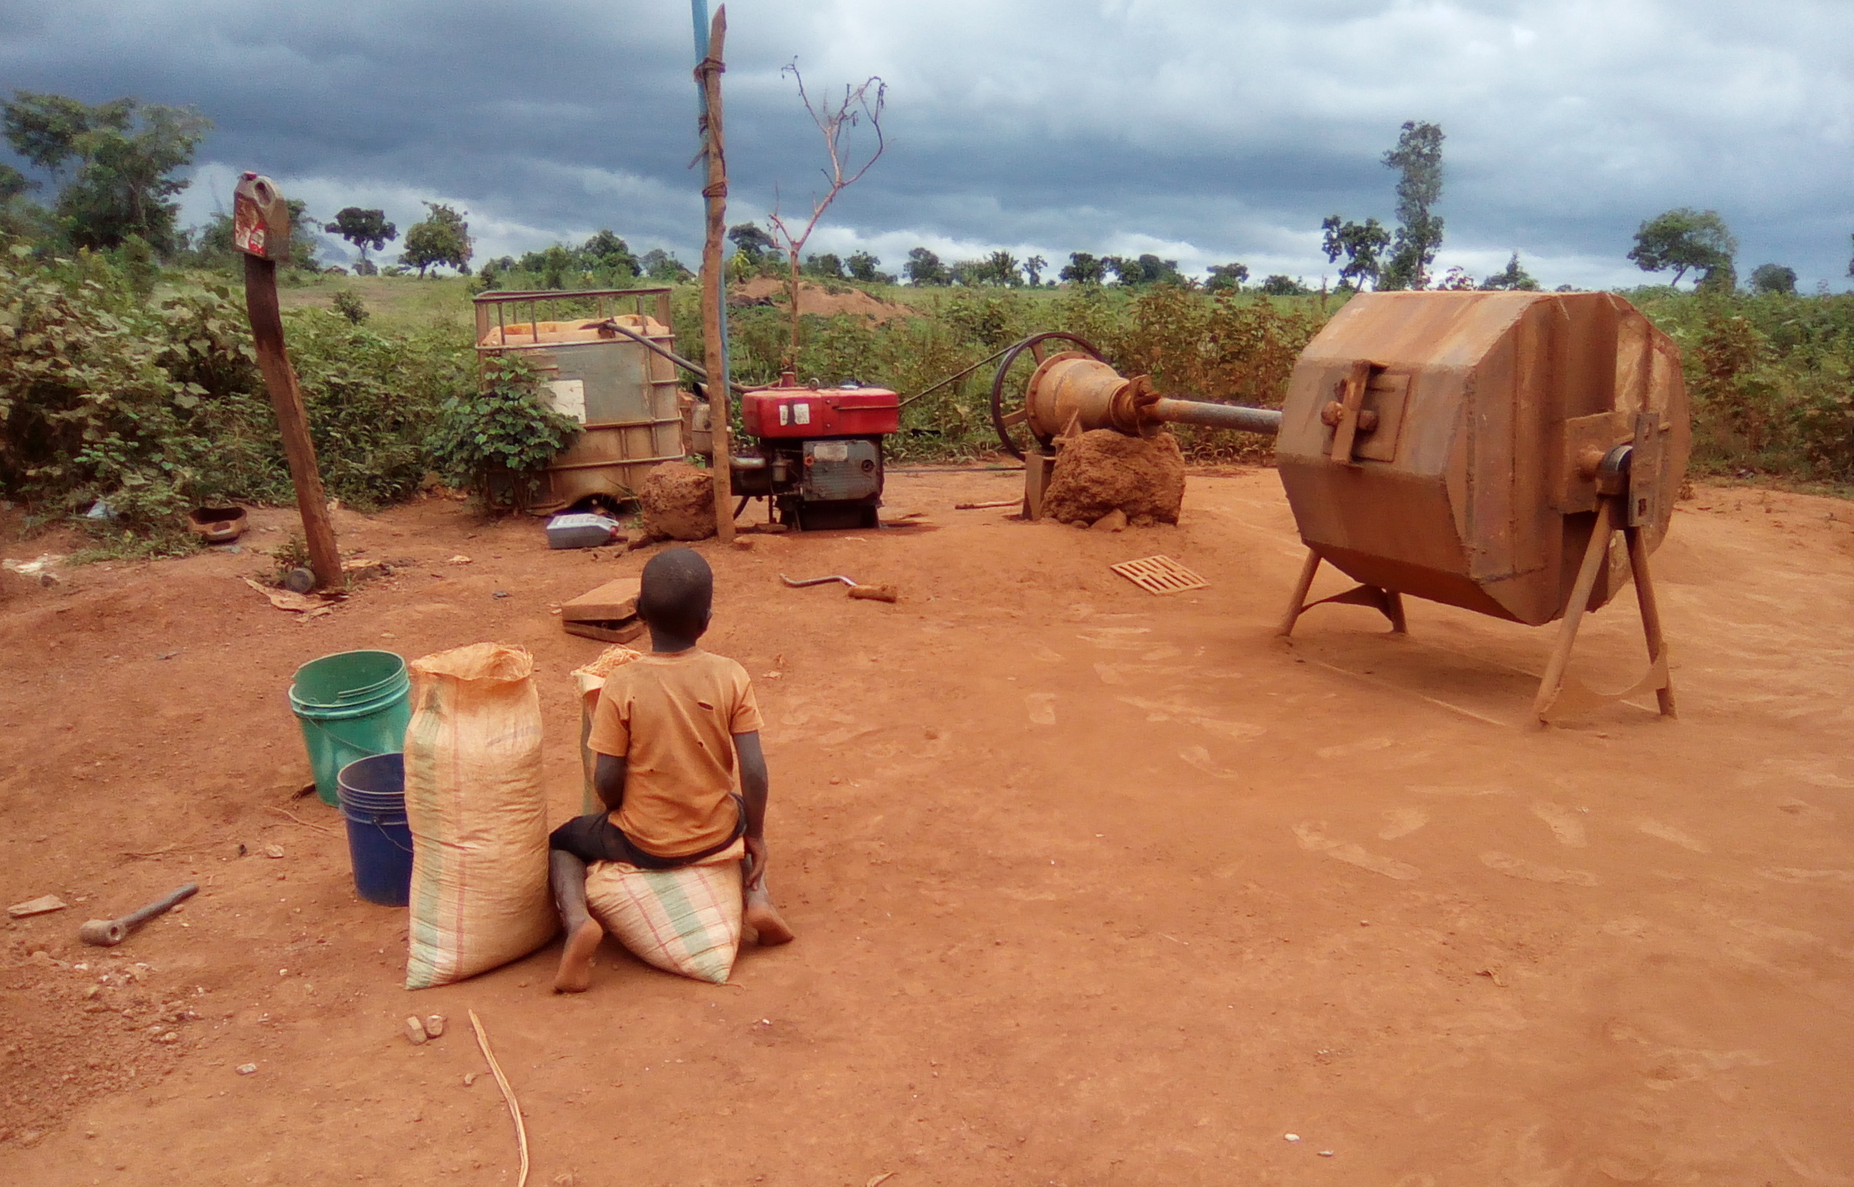
The social, economic and human rights impact of mining: the case of Tanzania
Programme
12:15 Walking lunch
Introduction to IPIS’ work
by Filip Reyniers, IPIS Director
12:45 Key note (Stevin room)
‘Studying the socio-economic and human rights impact of mining: the case of Tanzania’
By Hans Merket and Elard Mawala - IPIS
13:20 Q&A
13: 50 Closing remarks
Honorary Ambassador Johan Swinnen, IPIS chair
When
Wednesday 11 December 2019
12:15pm - 2pm
Where
Paleis der Academiën
Lipsius room/Stevin room Hertogsstraat 1 1000 Brussel
Register Before 5 December 2019 at
han.verleyen@ipisresearch.be
For more info, contact han.verleyen@ipisresearch.be

